Slide 1
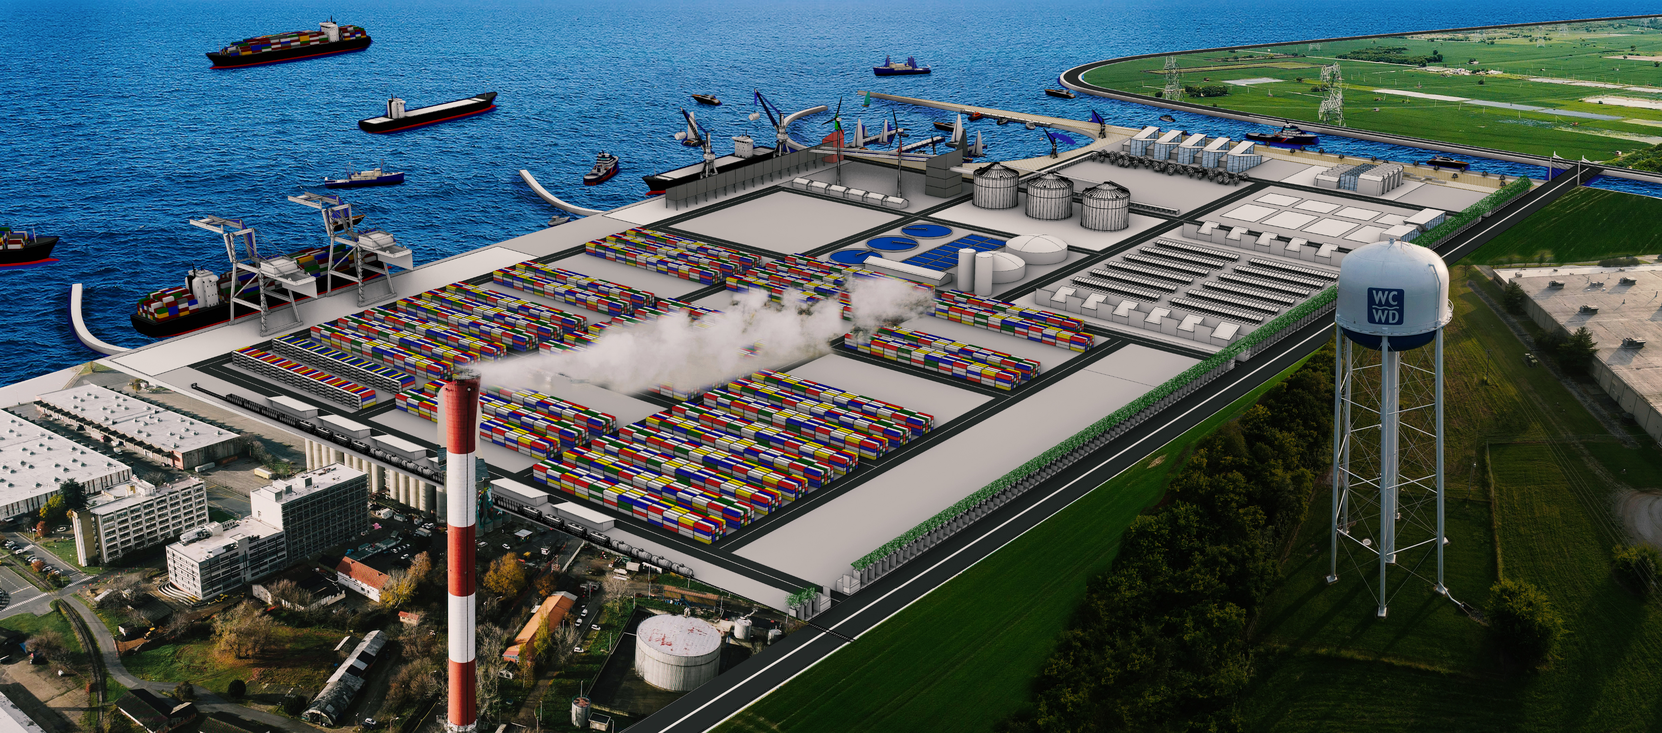

Intelligence Hunt Spring 2025
Xanadu Port Development Project
Modern Expeditions
(Reijo, Joseph, Surekha, Farid, Aaro)
Notes:
Hi everyone, welcome to our Xanadu ports development project
We are ME, and my name is Joseph.
The Port of the Future – Where Automation Meets Human Innovativeness. Imagine a port where cutting-edge automation and human expertise work in perfect harmony—where efficiency doesn’t mean compromise, but opportunity.

Slide 2
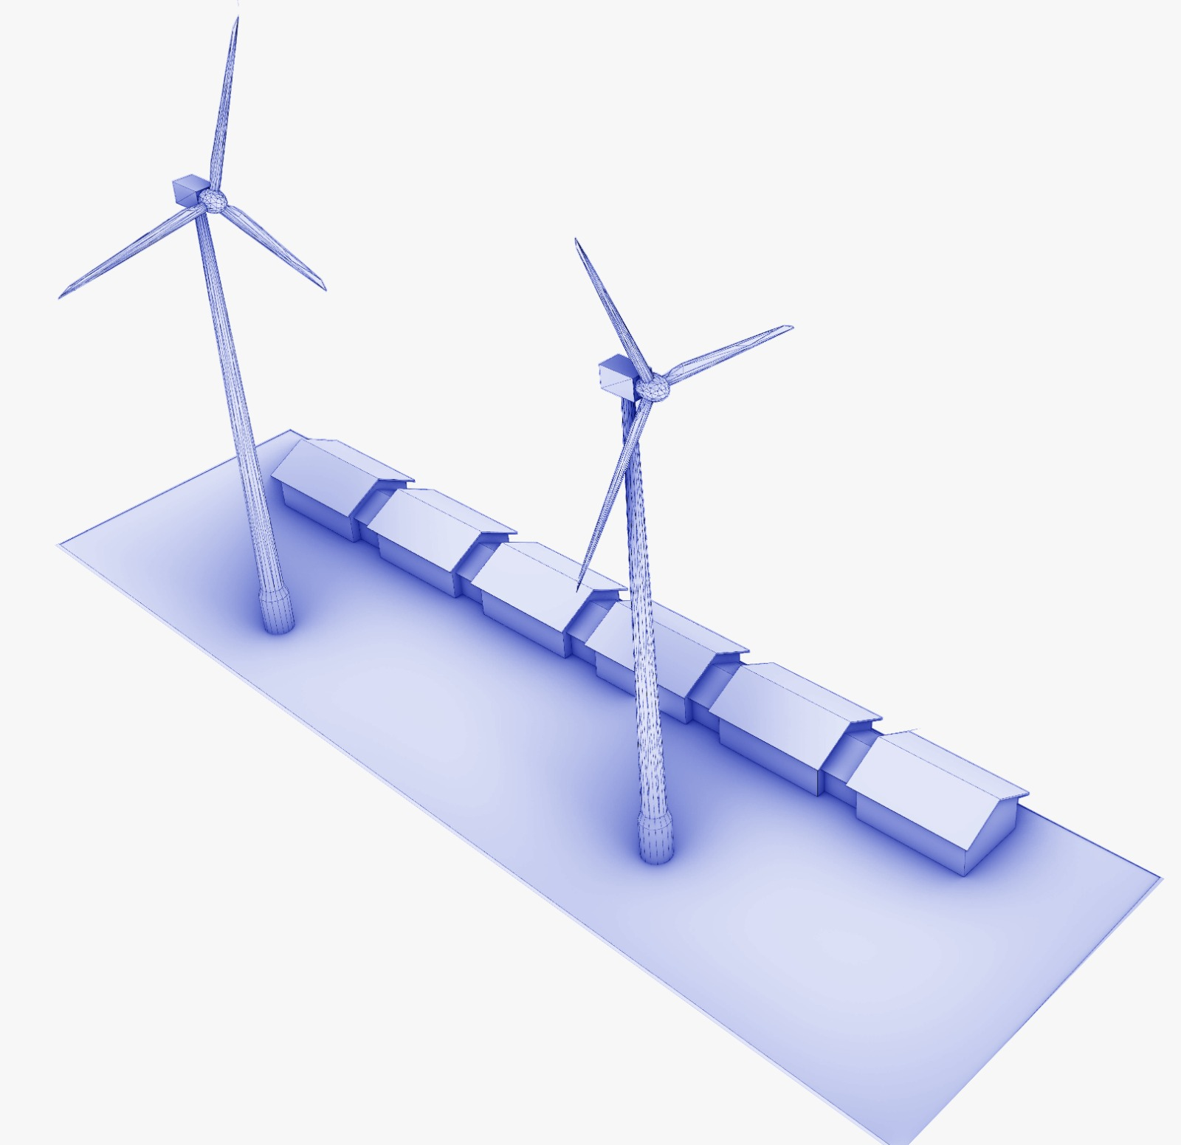

Achieving Carbon Neutral Energy Production
Renewable energy-based production plan
Current Priorities
Future Opportunities
2 Wind turbines + solar panels on unused surfaces supported by the grid.
Providing shore power to ship will reduce emissions by the vessels at the port.
Solar
Wind
80% of the energy requirements
2 additional turbines + solar farm
Shore power to ships
Notes:
so when it comes to the energy requirements will be focusing renewable energy resources. One is solar and wind while wind will be the main contributor. The two wind turbines will be installed will be producing 12 million kilowatt hours per year, which should give us 80 to 90% of the ports energy requirements. We also propose two future installations of wind turbines and a solar farm, which will allow us to provide shore power to the ships reducing the carbon emissions of the ships when docked. Next well be talking about our waste water management system which also contributes to the energy production in the city.
Focus on in house renewables.
Solar panels to be installed on all roofsurfaces and future expansion of a solarfarm.
Installing 2 wind turbines with a totalcapacity of 4 – 6 MW.
Cost - 4 million USD
Covering majority of the port powerconsumption.
Excess will be sold to the grid and ifpossible stored as heat.

Slide 3
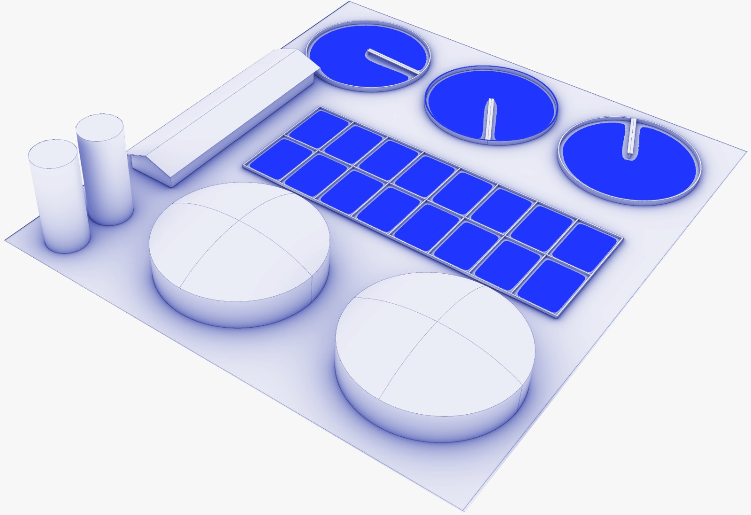

No Water Wasted Factory.
Producing a carbon neutral energy source and food for the plants
Water treatment
Released to the sewage system or reused
Methane
Sold to the city for energy production
Manure
Sold to the agriculture sector
Powered by renewables
Anaerobic treatment
Notes:
when it comes to the water was water treatment facilities, we have gone with an Expanded Granular Sludge Blanket bioreactor anaerobic system, which produces less greenhouse gases and also uses less electricity. And we get valuable by products such as methane and sluge cakes, the sludge cakes produced can be sold to the agricultural farms as manure and also methane then can be sold to the city to produce electricity as well.
Waste water treatment to be done using Expanded Granular SludgeBlanket (EGSB) bioreactor.
Solar energy will be utilized in theprocess as well.
Byproduct such as methane and sludge cakes can be sold to the cityand the agriculture sector as fuel andmanure respectively.
Cost – 2 million USD.
Possibility of handling someagricultural waste.

Slide 4
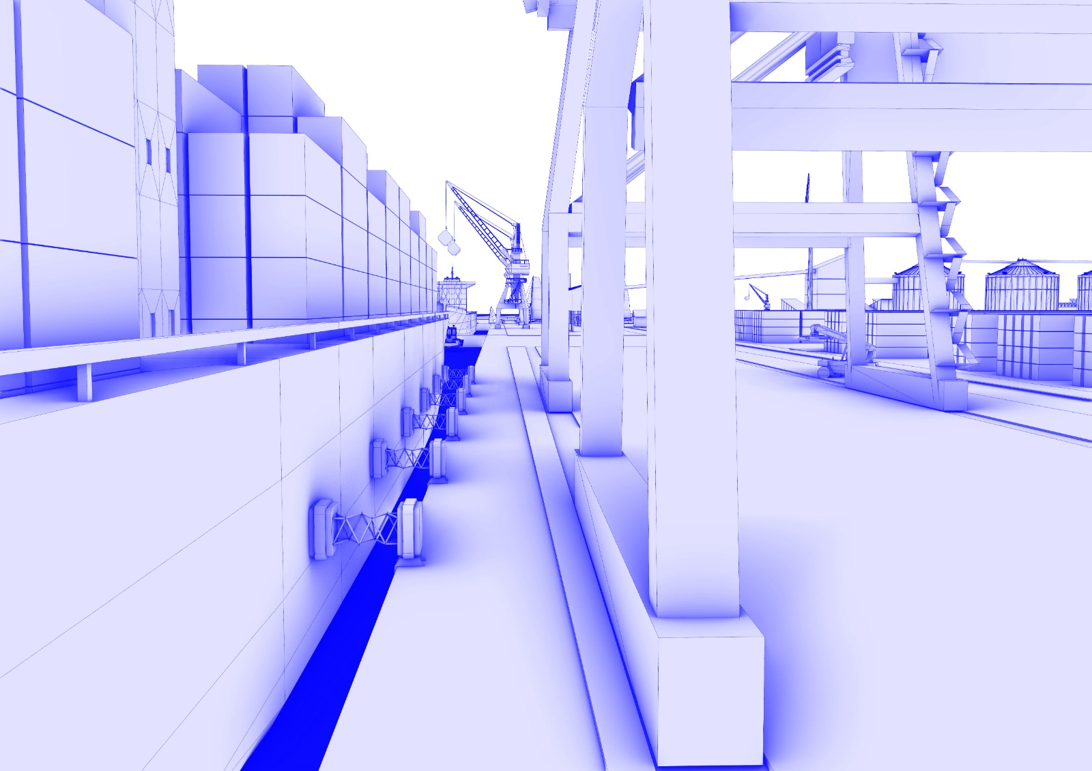

Automated Mooring System
Automated vacuum mooring system facilitate and improve the docking and mooring of vessels at terminals or harbors.
Notes:
Thank you Joe. Automated vacuum mooring systemfacilitate and improve the dockingand mooring of vessels at terminalsor harbors.For dockworkers and ship crews, mooring has long involved the use of heavy lines, ropes, and tugboats, which may be time-consuming, dangerous, and labor-intensive.By employing suction units or vacuum pads mounted on the dockside to safely attach boats directly to the berth structure, vacuum mooring fully transforms this process.

Slide 5
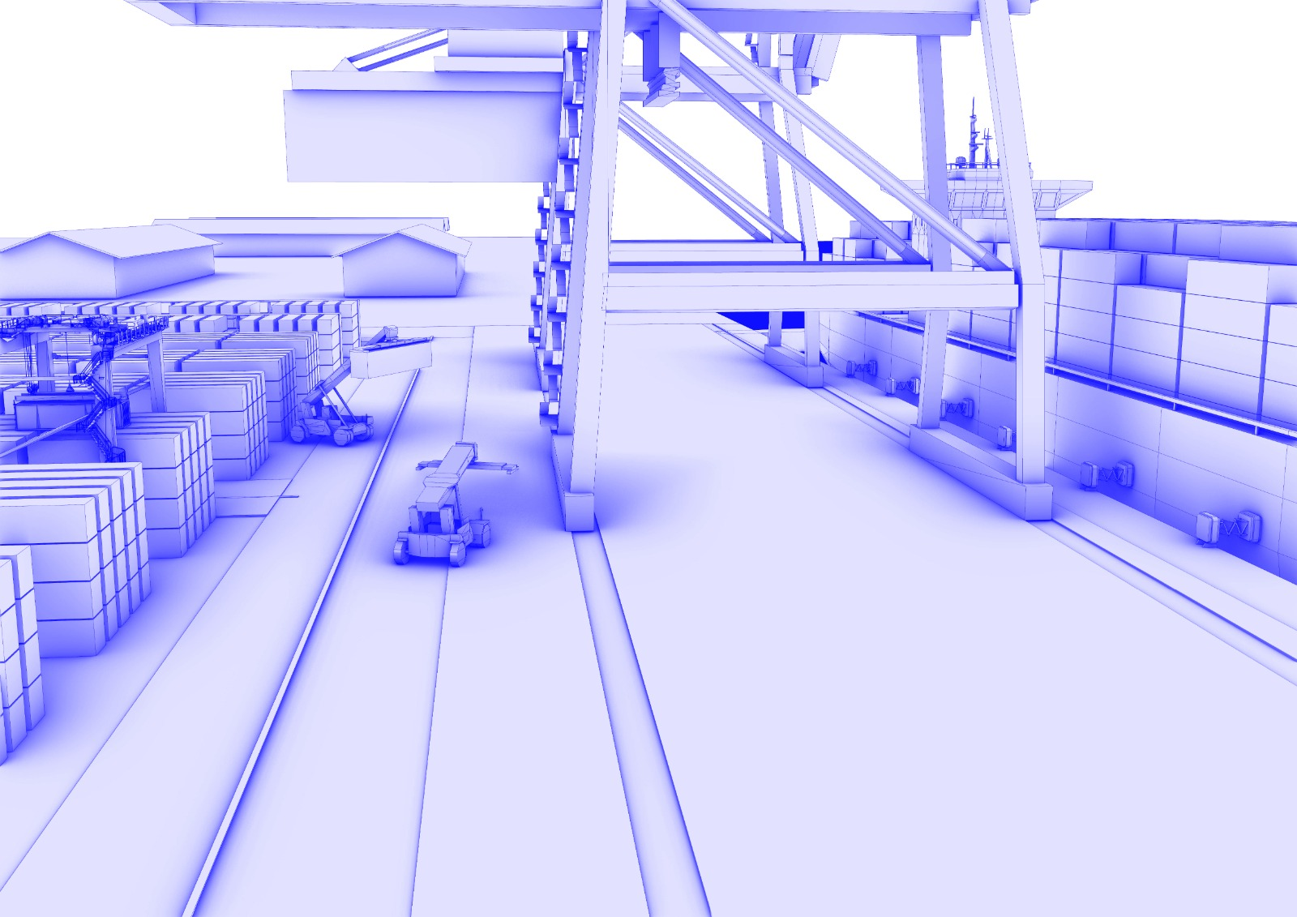

Vacuum Mooring: Faster, Safer and Smarter Docking
Eliminates Tugboat Dependency → Saves $1000/hour (Xanadu) & $2500/hour (Olbia).
Faster Berthing → Cuts docking time from 25 min to ~30 sec.
Higher Throughput → More ship calls per year.
Safer & Greener → No manual rope handling, fewer accidents, lower emissions.
Lower Fuel Costs → Less idling while waiting for berth.
Notes:
Automated Vacuum Mooring System offers a high-impact, cost-effective, and sustainable solution to modernize Xanadu Port’s berthing process. By combining operational efficiency with safety and environmental benefits, the system supports long-term growth while reinforcing the port’s reputation as a leader in smart maritime infrastructure.Now my teammate Farid will present

Slide 6
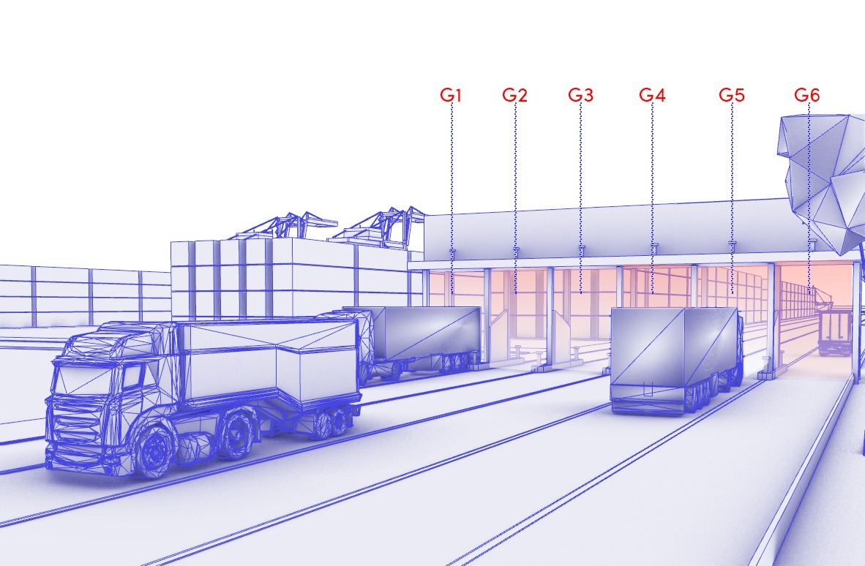
Streamlining Gate Operations
Key Issues:
Slow Processing → 1–5 mins per check-in.
Poor Data Quality → Causes inefficiencies.
High Labor Costs → $530,000 annually.
Proposed Solutions:
RFID-Based Identification
ANPR (Automatic Number Plate Recognition)
Digital Queue Management
Automated Barrier Gates
Centralized Gate Control Software
Projected Impact:
70% Faster Processing $290,000 Annual Savings ROI in 7 Months

Slide 7
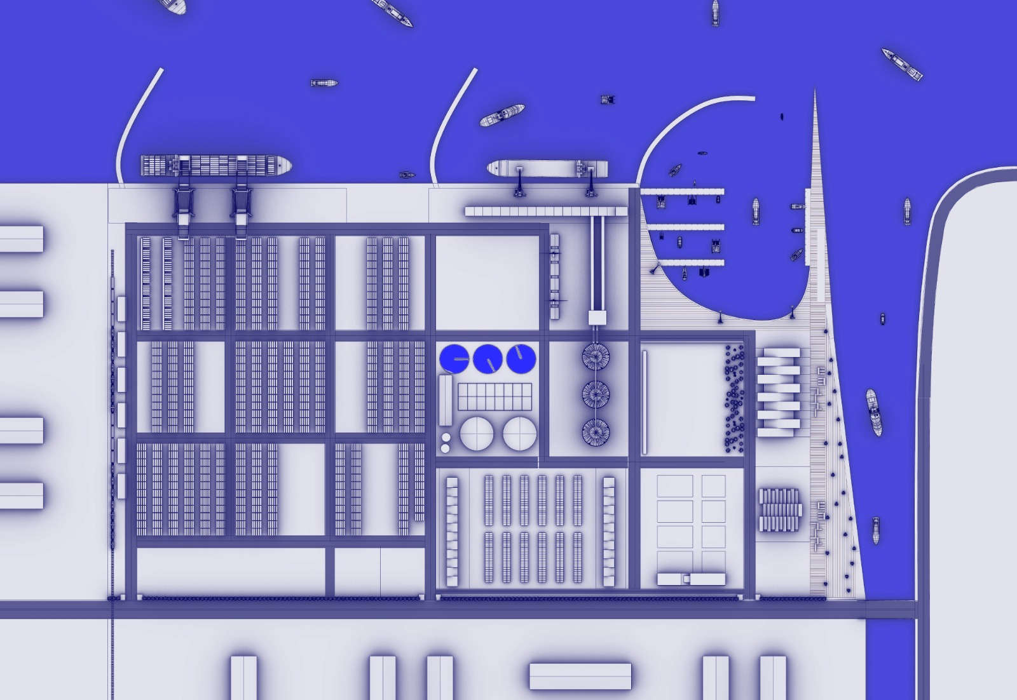
Container & Terminal Efficiency Optimization
Current Challenges:
Diesel-Powered Equipment, Manual Tracking & Stacking & No Real-Time Reefer Monitoring
Proposed Solutions:
Electrify Straddle Carriers & Forklifts, Automated Stacking Cranes (ASC), IoT-Based Reefer Monitoring & AI-Driven Digital Container Tracking
Projected impact
30% Faster Stacking, 25% Greater Yard Efficiency, $850,000 Annual Savings & ROI in 11 Years (Phased implementation for cost optimization)

Slide 8

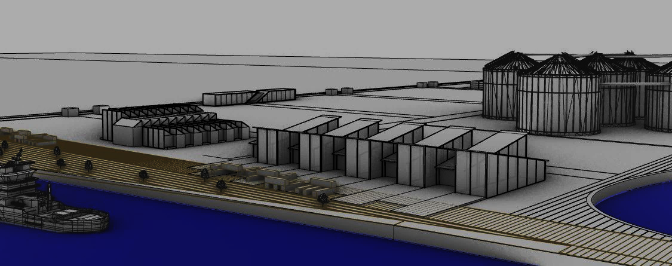


Driving Smart Port Innovation
Marketing Plan for Xanadu Maritime Hub
Development Hub
Marketed for smart port development and education.
Attracts other ports for learning opportunities.
Economical Impact of Maritime Hub
Renewed Fish Market
Converted into a maritime hub, which promotes education and tourism.
Hosts visitors in restaurant and conference rooms.
Source of Revenue
Estimated number of visitors 50,000 – 100,000 annually, increasing Xanadu ports income by 3,4%-annually.
Additional revenue created through innovation partnerships and training.
Notes:
Thank you, Farid.
I’m here to present Xanadu Port’s transformation into a leading maritime hub through smart port innovation. Our marketing plan focuses on three key initiatives: First, the Development Hub will position Xanadu as a pioneer in smart port education, attracting 10–20 regional ports annually for training, generating up to $1 million in revenue. Second, the Renewed Fish Market will draw 50,000 to 100,000 visitors yearly, boosting tourism and education. Third, these efforts will diversify revenue streams, increasing income by 3.4%, or $2.5 million annually, as shown in the chart. This positions Xanadu as a regional leader in maritime innovation.
Next, we move on to developing our supply chains.

Slide 9
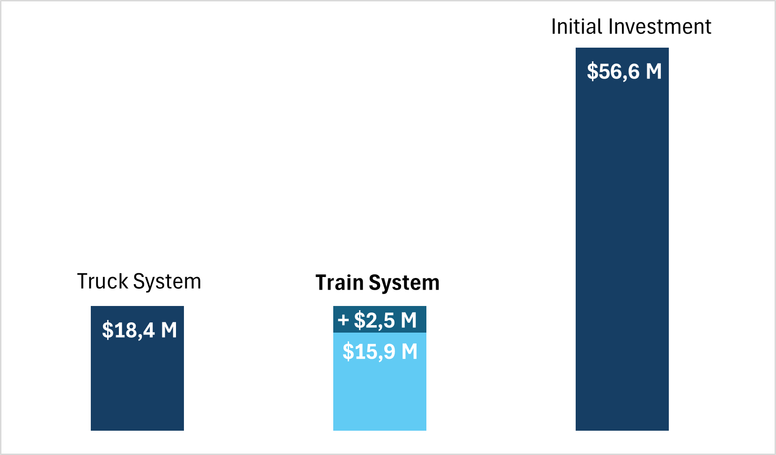
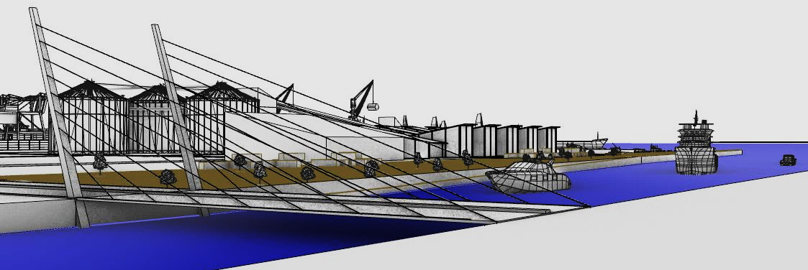
Rail-Based Supply Chain saves $2,5 M in operation costs
Connecting Xanadu port by a railroad and a bridge to the nearest town simplifies the logistical supply chain
Train Supply Chain
Bridge over Xanadu river
Comparison of Operational Costs and Train Systems Initial Costs
Utopian Growth by a bridge over Xanadu river
Enhancing Xanadu Ports regional trade opportunities by adding transportation opportunities to the port.
Reducing logistics costs and improving efficiency by providing direct river-crossing access for cargo and workforce
In Savings
Switching to a train system cuts cargo handling costs by 2.5M Shay annually (13.7%), enhancing efficiency and having an ROI of 20 years.
Lower emissions per ton-mile compared to trucks align with sustainability trends, qualifying for green funding or incentives.
Architect's vision for a “Utopian Growth” bridge
Notes:
Hence, let’s explore how Xanadu Port can enhance efficiency with a rail-based supply chain and a bridge over the Xanadu River. Our analysis shows that shifting to a rail system will save $2.5 million annually in operation costs—a 13.7% reduction—as seen in the bar chart comparing truck and train costs. The $56.6 million investment offers a 20-year ROI, potentially shortening to 10–15 years with increased cargo throughput. Additionally, the bridge will unlock trade opportunities and improve logistics by providing direct river-crossing access, driving utopian growth. Together, these initiatives position Xanadu as a forward-looking maritime leader. And then we move on to the conclusion.

Slide 10
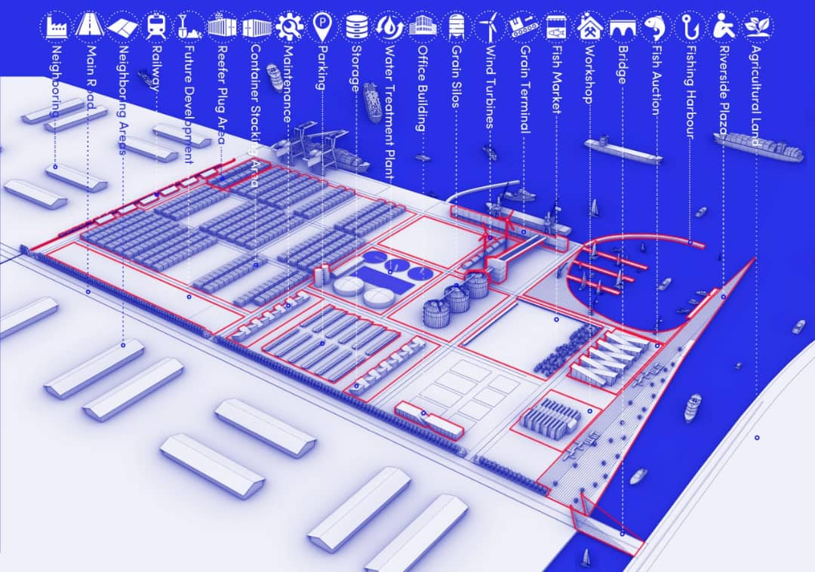

CONCLUSION
Notes:
I’d like to emphasize that we’ve developed a comprehensive 3D model of the port to explore the full range of development opportunities within the site's realistic spatial constraints.
So just to go over what we have done.
We have created a green port with wind, solar and waste management.
We have created a smart port by automating the gates, vehicles and mooring systems.
We have created a maritime hub and developments for the supply chain of the port.
Therefore, Xanadu port will become a green smart port, with a focus in quality first.
Thank you from the modern expedition group!

